Slide 1
STM32 – Encoder
Federica Villa

Slide 2
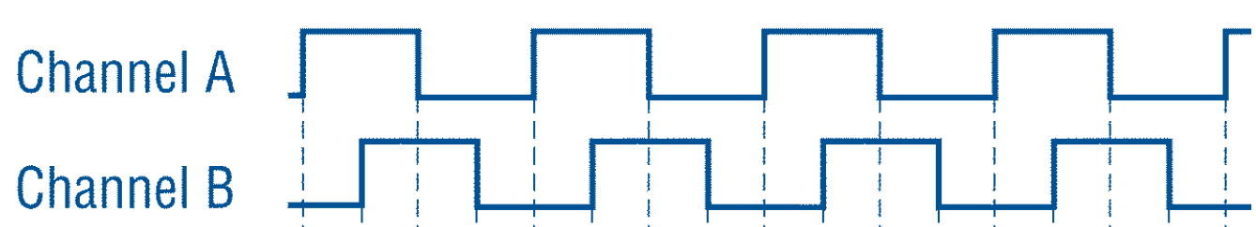
Incremental encoders
From: T 07 – Slide 61
Provide a specific number of pulses per revolution (PPR) in rotary motion, or per inch or millimeter in linear motion.
single channel output → doesn’t provide direction of movement
quadrature output → provides direction sensing
(two channels 90° out of phase)
To determine position, its pulses must be accumulated by a counter.
When starting up, the equipment must be driven to a reference or home position to initialize the position counters.
Some incremental encoders also produce another signal, the “marker,” produced once per revolution.

Slide 3
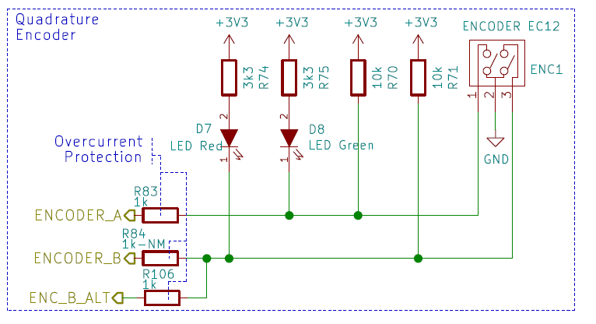
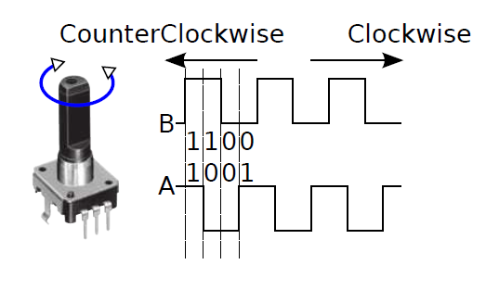
PMDB16: encode
PC7
PB3
PC6
The encoder is connected to pins PC6 / PC7 of the STM32
No hardware debouncing: we will use digital filtering
STM32 Timer peripherals feature dedicated encoder mode. Let’s setup the hardware

Slide 4
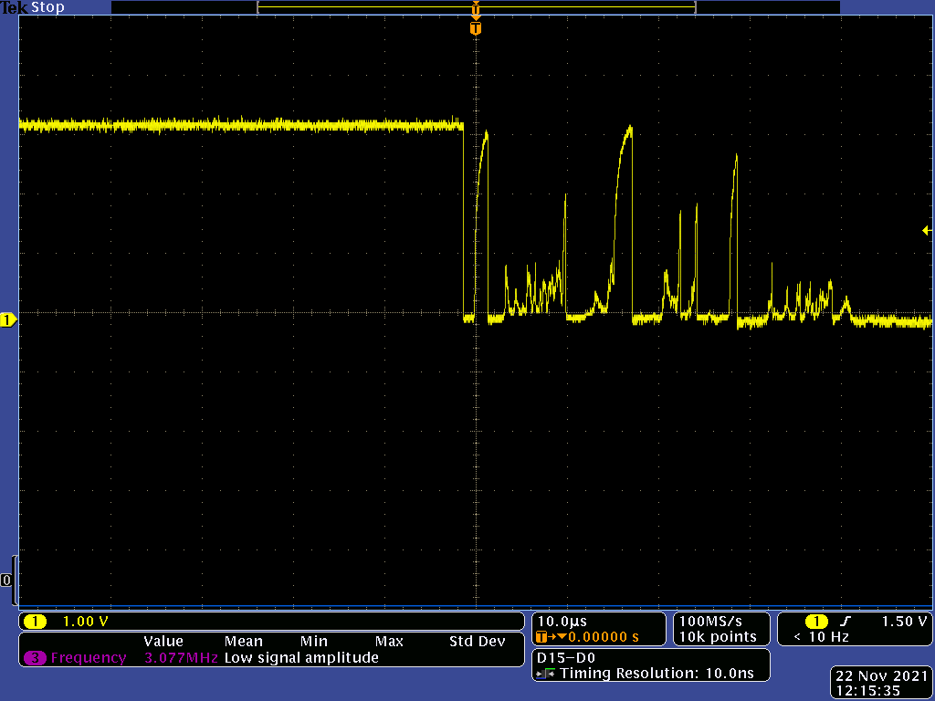
PMDB16: encoder debouncing
Bounces last a few microseconds

Slide 5
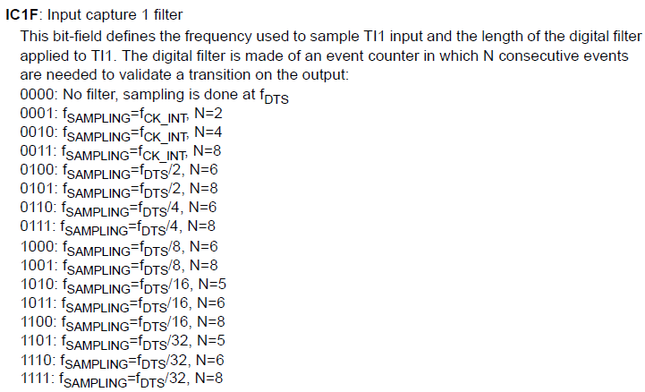
STM32 Timer input digital filter
Minimum pulse duration @ f_{CK_INT} = 84 MHz, CKD = 1 (CKD = 4)
Unfiltered: 11.9 ns (47.7 ns)
381 ns (1.52 µs)
3.05 µs (12.2 µs)
f_{DTS} = f_{CK_INT} / CKD (Internal clock division)

Slide 6
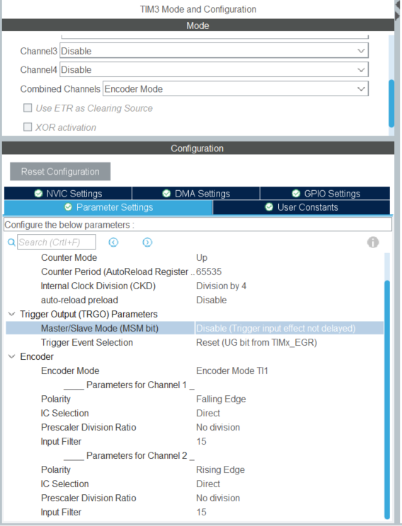
STM32CubeIDE: setup

Slide 7
Project 1a – Encoder readout
Objective
Read the encoder position and send to the PC the rotation speed in rpm

Slide 8
Aim of the project
Objective of the project is to readout a quadrature encoder, using the specific modality of STM32 timers, in order to provide the rotation frequency (expressed in rpm / rotations per minute) and direction (“+” for clockwise and “-” for counterclockwise).
The result must be displayed using the remote terminal.

Slide 9
Project hints
Identify the encoder pins, and enable then in TIMx_CHy mode
Setup the timer to operate in encoder mode, with the correct input filter applied. Start the timer in encoder mode.
Within the while(1) loop, poll the counter value every second and compute the delta from the previous read, then convert it to rpms. How many counts does a full rotation of the encoder provide?
Beware of overflow and underflow of the timer. How to solve this issue?
Compile and debug the code.

Slide 10
Project 1b – Encoder readout
Objective
Read the encoder position and send to the PC the rotation speed in rpm
Use a timer as a timebase and DMA to transfer the UART data

